Slide 1
5 Papers
Title | Publication source | Year
Using co-change histories to improve bug localization performance | SNPD | 2013
An Approach to Detecting Duplicate Bug Reports Using Natural Language and Execution Information | ICSE | 2008
Combining Word Embedding with Information Retrieval to Recommend Similar Bug Reports | ISSRE | 2016
Poster: DWEN: Deep Word Embedding Network for Duplicate Bug Report Detection in Software Repositories | ICSE | 2018
Leveraging Syntax-Related Code for Automated Program Repair | ASE | 2017

Slide 2
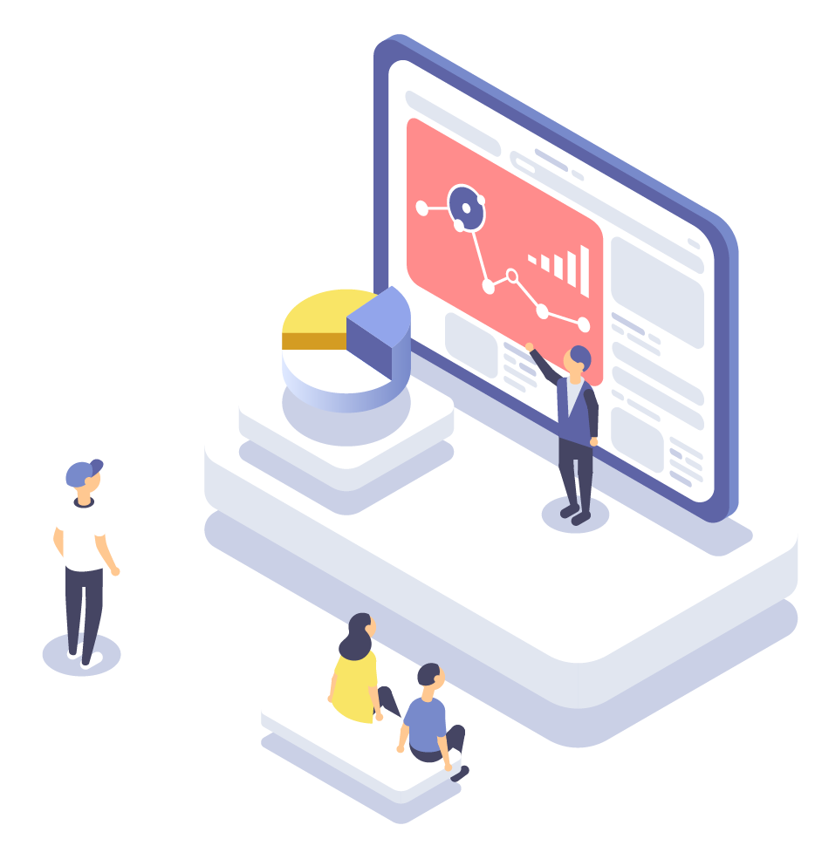

Combining Word Embedding with Information Retrieval to Recommend Similar Bug Reports
汇报人：王昭丹

Slide 3

CONTENTS
01. INTRODUCTION
02. DATA COLLECTION & PREPROCESSING
03. PROPOSED APPROACH
04. EXPERIMENTS AND RESULTS

Slide 4
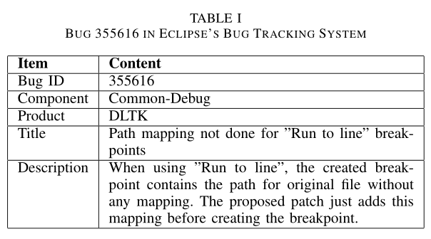
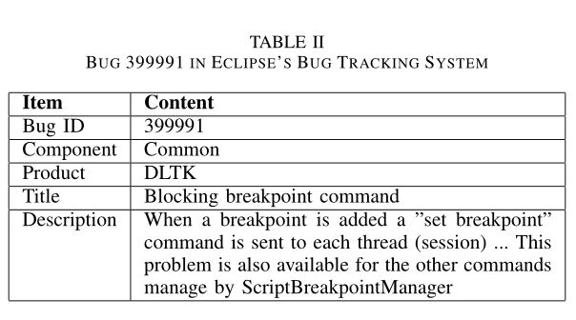
INTRODUCTION
Similar Bug
Bugs handle of many common source code files.
Not Duplicate !
Same product
Same component
Handle the same file
“core/plugins/org.eclipse.dltk.debug/src/org/eclipse/dltk/internal/debug/core/model/ScriptBreakpointManager.java”

Slide 5
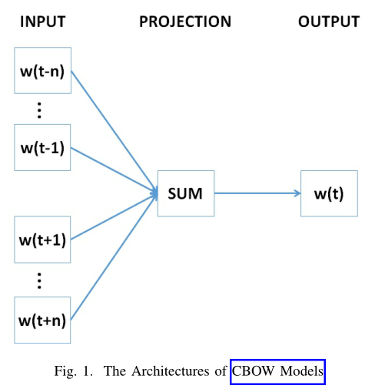
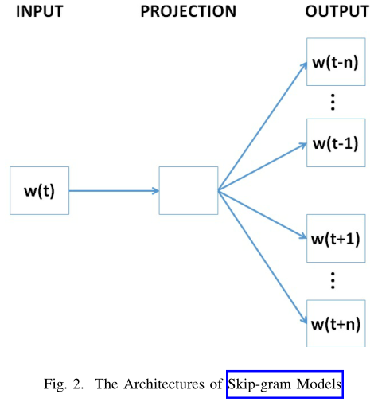
distributional hypothesis
INTRODUCTION
distributional semantic models (DSMs)
Word Embedding
count-based models
CBOW model predicts the current word based on its context
Skip-gram model predicts the surrounding words given the current word
based on neural network，word embedding
w(t) represents the current word
w(t±i) (i=1,2,...,n) represents the surrounding words of w(t)
√

Slide 6
INTRODUCTION
Word Embedding
Similarity scores based on word embedding vectors
Similarity scores based on TF-IDF vectors
focus more on the relationship of words considering the context they appear
Complementary
Traditional IR Techniques
＋
focus more on the relationship of different documents in the whole corpus, such as TF-IDF
Compute and combine two similarity scores

Slide 7
DATA COLLECTION & PREPROCESSING
Collect bug reports from Eclipse and Mozilla, bug ids range from [1,400000]
Extract its title and description, the product and component information
Combine its title and description into a single document
Preprocess the document
Integrate the product and component information as a set
Preprocess the document
extract all the terms (i.e., words) from the document
remove stop words, numbers, punctuation marks and other non-alphabetic characters
use the Snowball stemmer to transform the remaining terms to their root forms
Extracting Information From Bug Reports
Note: use bug reports submitted at least 3 years ago
For the product and component information: directly extract them from two fields of bug reports, product field and component field
each bug corresponds to a set, set = {p, c}, p - product information, c - component information

Slide 8

DATA COLLECTION & PREPROCESSING
Collect 3,838,708 commit logs of Eclipse and Mozilla from GitHub
Use the approach proposed by Sliwerski et al. to extract bug ids from commit messages
Union the committed file lists which correspond to the same bug id
Link bug reports and committed file lists according to the bug ids
Building Ground Truth
use the method proposed by Rocha et al. to label similar bugs
given two bugs x and y, calculate the ratio of mutually committed files —— Mutual(x, y)
set a threshold for Mutual(x, y)
compare each pair of bugs and label all the similar bugs as the ground truth
13,337,653 pairs of similar bugs in Eclipse
10,596,675 pairs of similar bugs in Mozilla
Fx and Fy represents the committed file lists of x and y

Slide 9
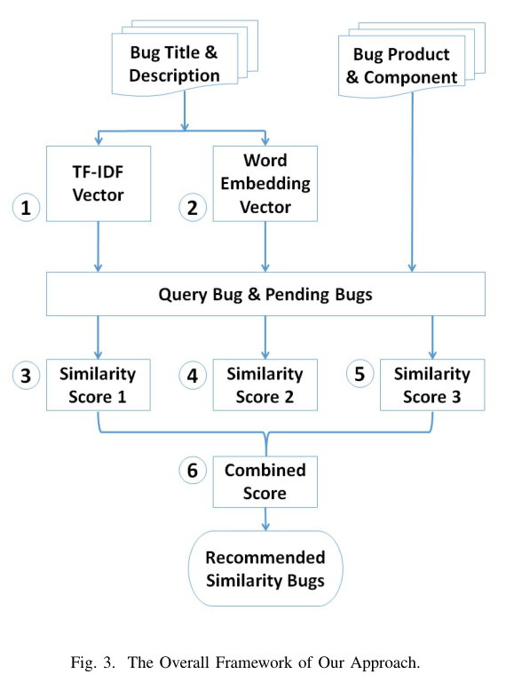
PROPOSED APPROACH —— OVERALL FRAMEWORK
TF-IDF component
word embedding component
product & component information component
combination component
Four components

Slide 10
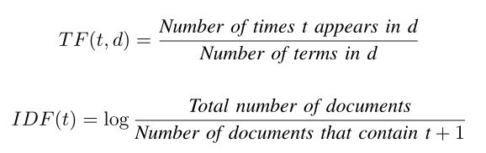





PROPOSED APPROACH
TF-IDF Vectors
Word Embedding Vectors
Given a term t and a document d, define TF and IDF as follows:
Given a word w, the set of the surrounding context words of w as Cw.
The objective function J of a skip-gram model:
vector representation of the word w
given a document matrix that has n rows
the i-th row of the matrix as ri
transformed document vector vd
vocabulary of all words
Given two TF-IDF vectors v1 v2
cosine similarity
cosine similarity
Score2
Notes:
All the words in the vocabulary of the corpus can be represented as a d-dimensional vectors.
Transform the document matrix into a vector by averaging all the word vectors the document contains

Slide 11


PROPOSED APPROACH
Product & Component Information
Similar Bug Recommendation
Almost all similar bugs are in the same product and component.
Given two bugs, denote their corresponding sets as set1 and set2. The similarity score Score3 is：
Score1 is generated based on TF-IDF vectors, which focus more on relationship of different documents in the whole corpus.
Score2 is generated based on word embedding vectors, which focus more on the relationship of words considering the context they appear.
Score3 can be seen as a filter.
Notes:
All the words in the vocabulary of the corpus can be represented as a d-dimensional vectors.
Transform the document matrix into a vector by averaging all the word vectors the document contains

Slide 12
EXPERIMENTS AND RESULTS
Evaluation Metrics
Experimental Settings
Recall-rate@k: checks whether a top-k recommendation is useful.
MAP (Mean Average Precision): the mean of the Average Precision (AvgP) values obtained for all the evaluation queries.
MRR (Mean inverse Rank): the mean of the Reciprocal Rank (RR) values obtained for all the evaluation queries.
All bugs in our datasets are regarded as query bugs once.
Given a query bug q, only recommend its potential similar bugs whose bug ids are less than that of q.
Word embedding technique is applied by using the python package gensim1.

Slide 13
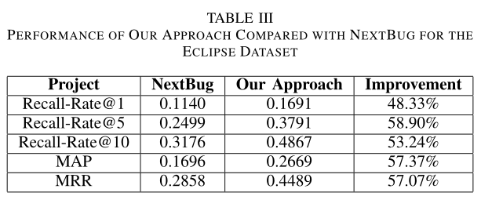
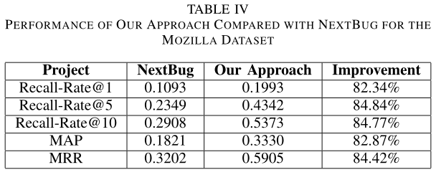
EXPERIMENTS AND RESULTS
How effective is the approach to
recommend similar bugs
Compare the approach against NextBug
Set the threshold as 0.3 for NextBug
Improvement: nearly 60% for the Eclipse dataset and nearly 85% for the Mozilla dataset in terms of all the metrics
1

Slide 14
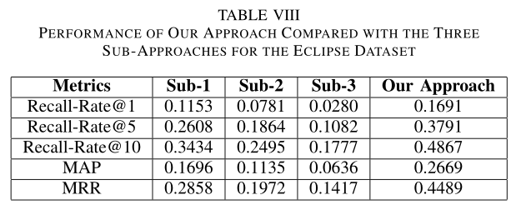
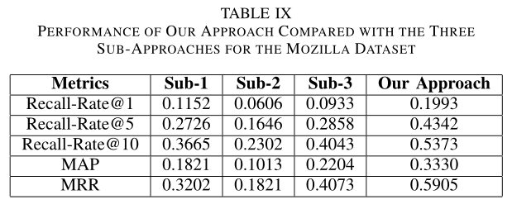
EXPERIMENTS AND RESULTS
Does the combined similarity score generated by the approach works better than the three individual similarity scores?
Compare the approach with three incomplete versions – Sub-1, Sub-2 and Sub-3.
For Sub-1, only use the first similarity score, TF-IDF vectors;
For Sub-2, only use the second similarity score, word embedding vectors;
For Sub-3, only use the third similarity score, product and component information;
2

Slide 15
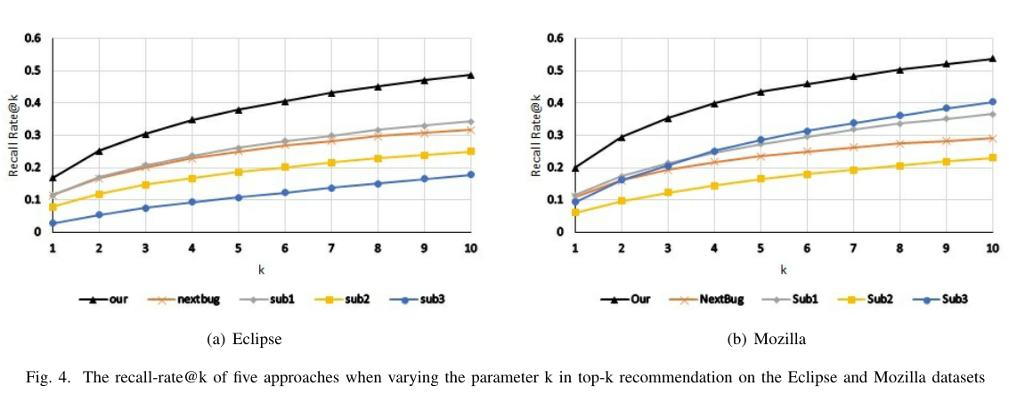
EXPERIMENTS AND RESULTS
Recommendation performance of the approach steadily rises with the increase of k and is better than those of the other four approaches by a large margin.

Slide 16
学习进展&暑期计划
感谢您的聆听
汇报人：王昭丹

Slide 17
Extracting Information From Bug Reports
first collect bug reports，bug ids range from [1,400000]，two large open-source projects，Eclipse and Mozilla
For each bug report, we extract its title and description as well as the product and component information.
combine its title and description into a single document
preprocess the document with the following steps
extract all the terms (i.e., words) from the document
remove stop words, numbers, punctuation marks and other non-alphabetic characters
use the Snowball stemmer [20] to transform the remaining terms to their root forms
For the product and component information, directly extract them from two fields of bug reports
integrate the two kinds of information as a set，set = {p, c}，p - product information and c - component information
Building Ground Truth
collect in total 3,838,708 commit logs of Eclipse and Mozilla from GitHub
use the approach proposed by Sliwerski et al. to extract bug ids from commit messages
union the committed file lists which correspond to the same bug id
link bug reports and committed file lists according to the bug ids

